Slide 1

AIRPORT DISTANCE CALCULATOR

Slide 2
Contents:
Overview
Software Requirements
Database
Back-End
Front-End

Slide 3
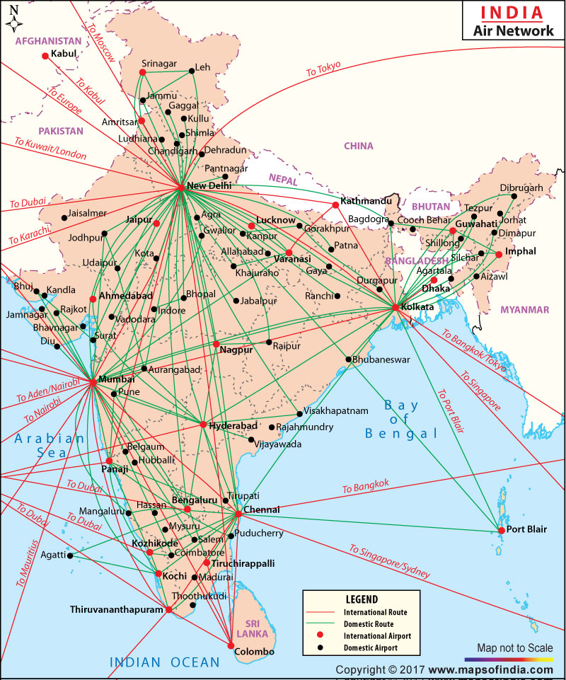
Overview
Our project is to calculate the distance between two airports.
The calculation part is based on the latitude and longitude points.
On the web page, the user should select the origin and destination places.
The response is shown once they click the Calculate Distance button.

Slide 4


Software Requirements
Front-End
Back-End
Visual Studio Code
Angular
HTML
BOOTSTRAP
Eclipse
Spring Boot
MySQL
Postman

Slide 5
Database
Table has been created in the name of flight_entity with the column names of,
id - primary key with auto-increment
iatacode
city
lattitude
longitude

Slide 6
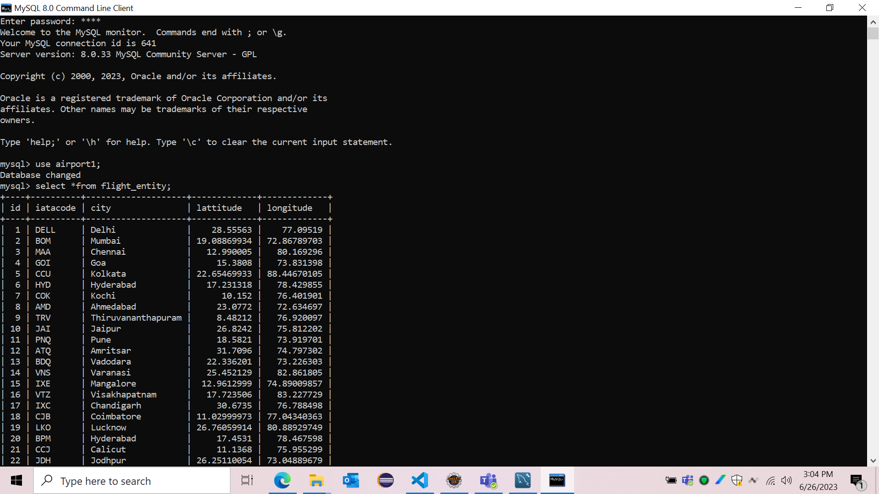

Slide 7
Back-end

Slide 8
Entity
Created a Spring starter project and added the required dependencies.
The entity bean class is created with the required constructor and parent constructor, along with its getters and setters, in order to define and fetch the data of the table.

Slide 9
Repository
JpaRepository is a particularly JPA-specific extension for Repository.
It has full APIs for CrudRepository and PagingAndSortingRepository.
So, basically, the JPA Repository contains the APIs for basic CRUD operations, the APIs for pagination, and the APIs for sorting.

Slide 10
Service
Service class is created that includes @Service annotation and allows developers to add business functionalities.
To calculate distance between two airports , formula was given in service class.

Slide 11
Controller
To do the CRUD Operation, the required bean class is created to established in the controller bean class of the user.
The request controller is called to take care of the mapping data to the defined request handle method.
To connect with the Front-End, CrossOrigin mapping is established.
CrossOrigin mapping is created in order to establish a connection with any other application along with the server of the spring boot application.

Slide 12
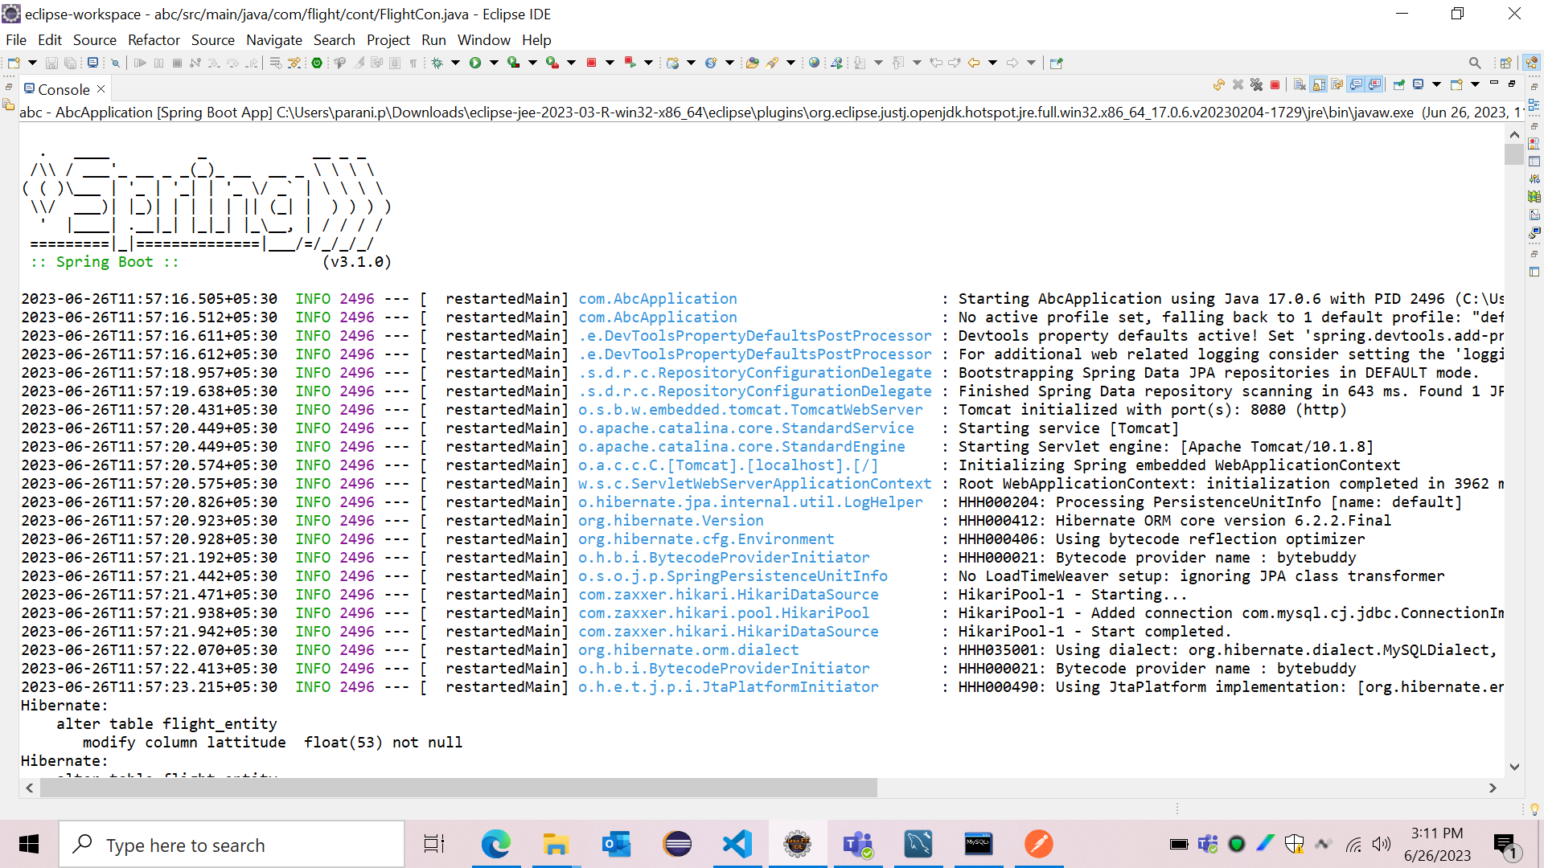

Slide 13
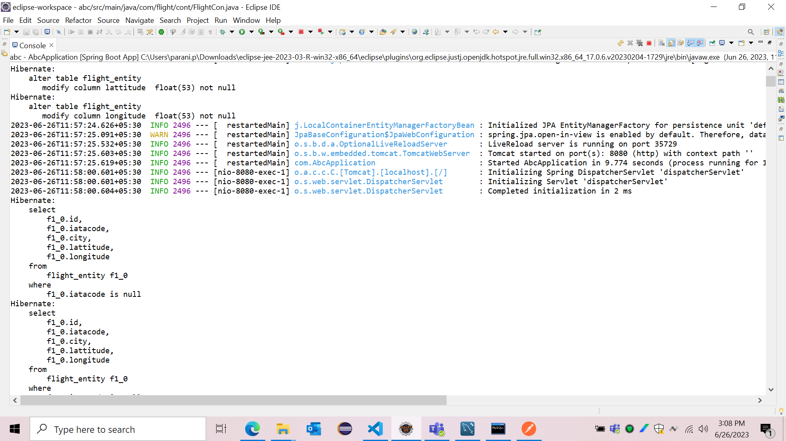

Slide 14
Postman
Since, the tomcat server uses the default port 8080, the data can be created in the database using POST with body as JSON format through POSTMAN.

Slide 15
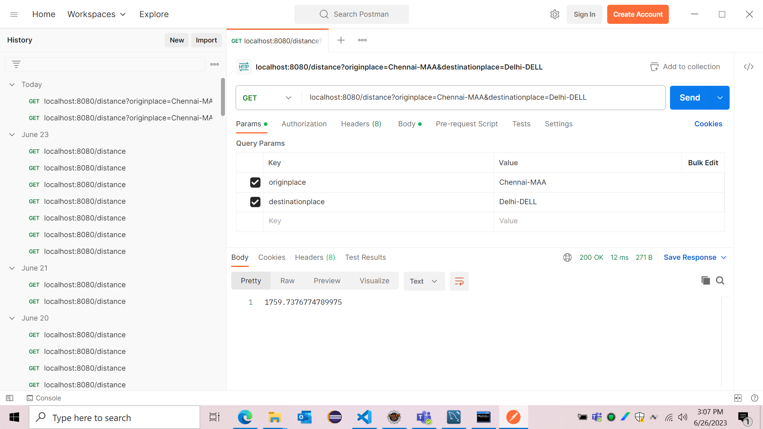

Slide 16
Annotations
@Autowired:
It can be applied on variables and methods for autowiring byType.
@GetMapping:
It handle the HTTP GET requests matched with the URI expression.
@Component:
It is used to denote a class as component.
@Service:
It is used with classes that provide some business functionalities.

Slide 17
Front-end

Slide 18
Angular
Angular is a development platform, built on TypeScript. As a platform, Angular includes:
A component-based framework for building scalable web applications
A collection of well-integrated libraries that cover a wide variety of features, including routing, forms management, client-server communication, and more
A suite of developer tools to help you develop, build, test, and update your code.

Slide 19
Components
A component controls one or more sections call view.
Component are denoted by @Componet. It has mostly .html, .CSS, .JS files.
@Component decorator provides the template and metadata.

Slide 20
Modules
To maintain modularity, we have angular modules. The root module, "appmodule", is always present.
It may contain one or more angular module or ngmodules depending on the demand.
Any angular module is a class with @ngmodule decorator.

Slide 21
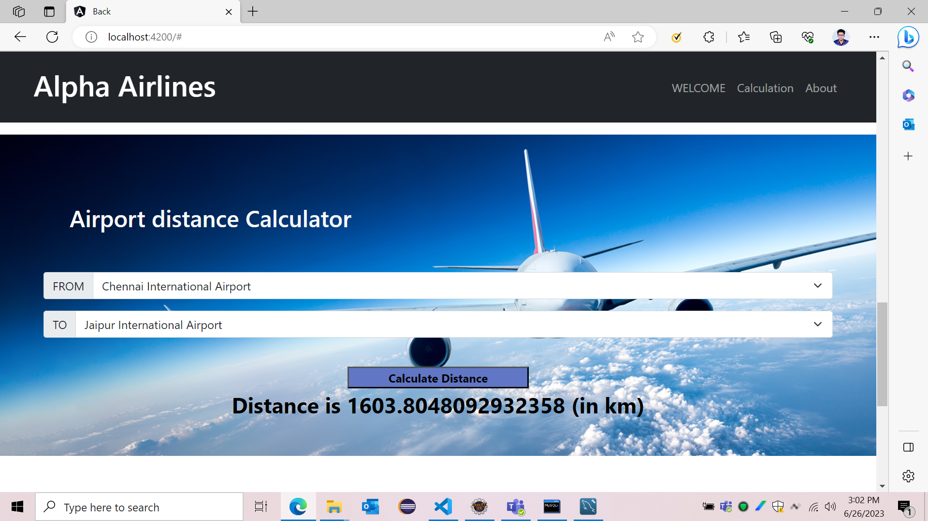

Slide 22
Thank You

